Slide 1
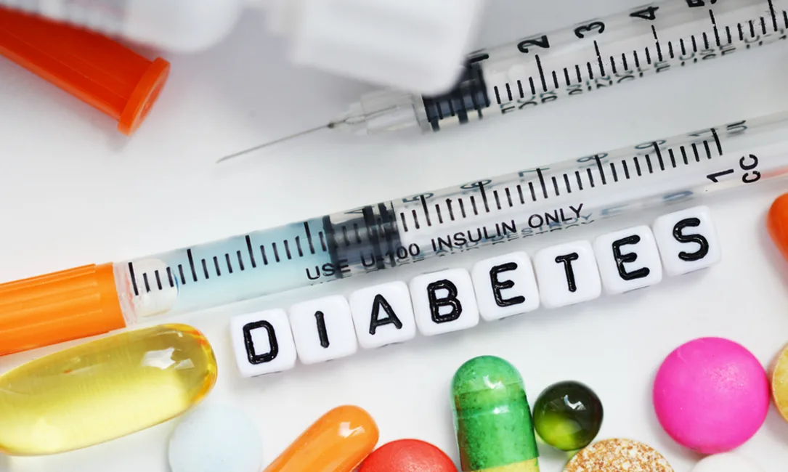
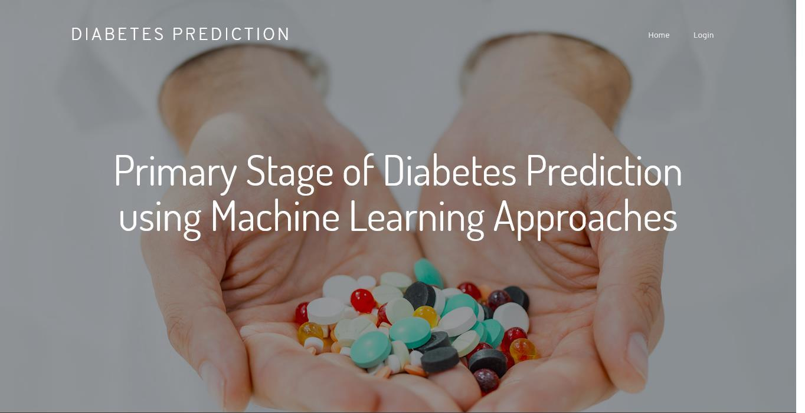
Health Monitoring System
A Review on Diabetes Prediction and Providing Medical Assistance to the Patients

Slide 2
MENTOR’S Mr. R.N. Panda Associate Professor & Addl. HOD KIET Group of Institutions, Ghaziabad Mr. Ankit Verma Associate Professor KIET Group of Institutions, Ghaziabad
STUDENTS
Sakshi Tyagi
2000290140110
MCA, KIET Group of Institutions, Ghaziabad
Shivani Chauhan
2000290140114
MCA, KIET Group of Institutions, Ghaziabad
Mukul Dhama
2000290140073
MCA, KIET Group of Institutions, Ghaziabad

Slide 3
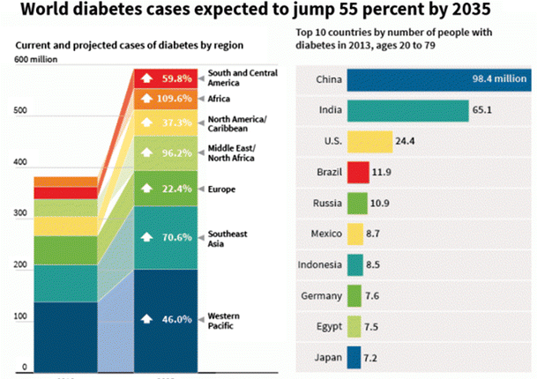
Problem:
Diabetes is one of the deadliest diseases in the world which is rapidly increasing. It is not only a disease but also a creator of different kinds of diseases.
Cause of diabetes vary depending on the genetic makeup, family history, ethnicity, health, etc.
It is an illness caused because of high glucose levels in human body.
Diabetes should not be ignored if it is untreated then Diabetes may cause some major issues in a person like heart related problems, kidney problem, blood pressure, eye damage ,etc.
Good thing is diabetes can be controlled if it is predicted earlier.
To achieve this goal our project will do early prediction of diabetes in a human or a patient .

Slide 4
Solution:
The aim of our project is to design and implement diabetes prediction using machine learning methods and performance analysis of those methods.
The techniques we are using SVM, K-nearest neighbour, decision tree, logistic regression, random forest.
Applying Machine learning Techniques to analyze the performance of these methods will help to find accuracy of the model.
It will help to figure out the responsible /important feature which play a major role in prediction.
Our result shows that random forest achieved higher accuracy compared to other machine learning technique.
Diabetes can be controlled if it is predicted earlier. Machine learning techniques will provide better result for prediction by constructing models from datasets collected from patients.

Slide 5
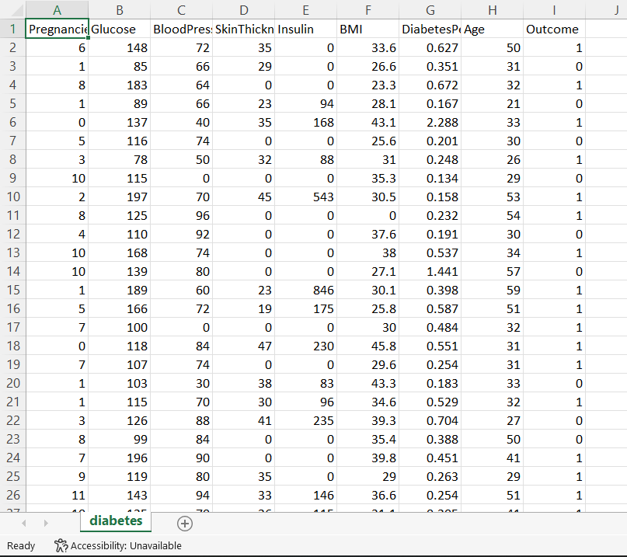
Data understanding :
The dataset consists of 768 samples. The dataset has total 9 attributes Pregnancies, Glucose, Blood pressure, skin thickness, Insulin ,BMI, Diabetes pedigree function, Age, Outcome out of which 8 are independent variables and one is the dependent variable i.e. target variable (outcome)which determines whether patient is having diabetes or not .
Sample data:

Slide 6
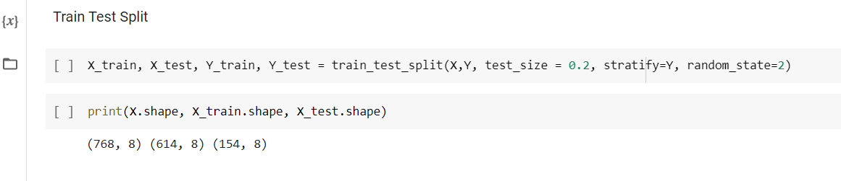
Data understanding:
Data splitting:
Data is divided into training and testing data into 80:20 ratio. 80% was training data and 20% was testing data.
Out of 768 records, 614 records were used for trained and 154 records were used for training

Slide 7
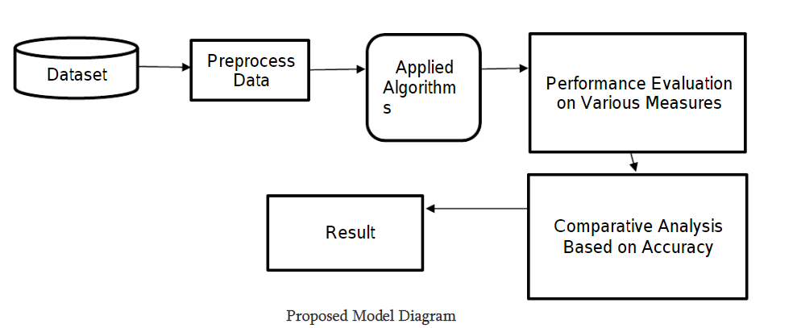
METHODOLOGY:

Slide 8
Algorithms used:
SVM
Decision Tree
KNN
Logistic Regression
Random Forest

Slide 9
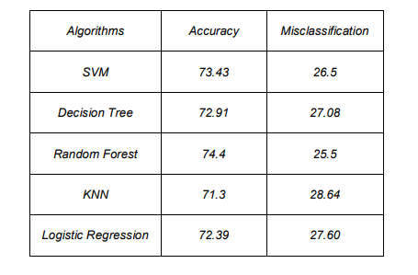
Result description:
In the given Table we can see the algorithm which gives the better accuracy on the data set.

Slide 10

Conclusion:
At last by using all these five machine learning algorithms we had measured different parameters within the dataset and we had came through better accuracy rate with random forest with nearly 75%. This work can be extended by adding any other algorithm which can give better accuracy than random forest.

Slide 11
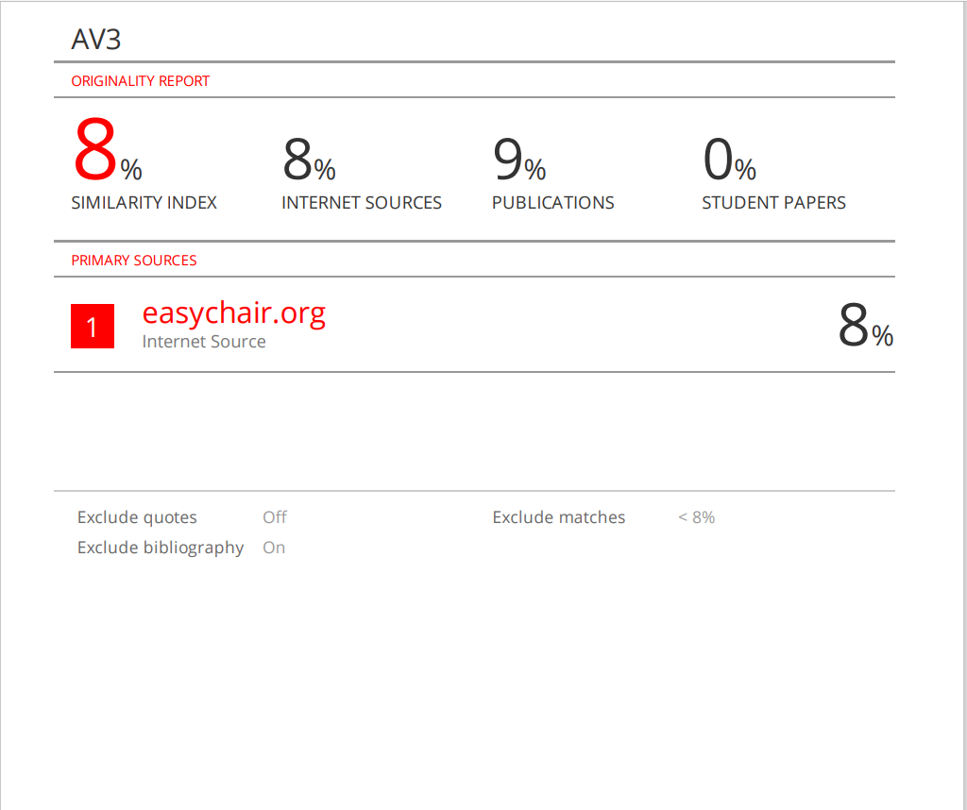
Report of research paper:

Slide 12

THANK YOU

